Slide 1

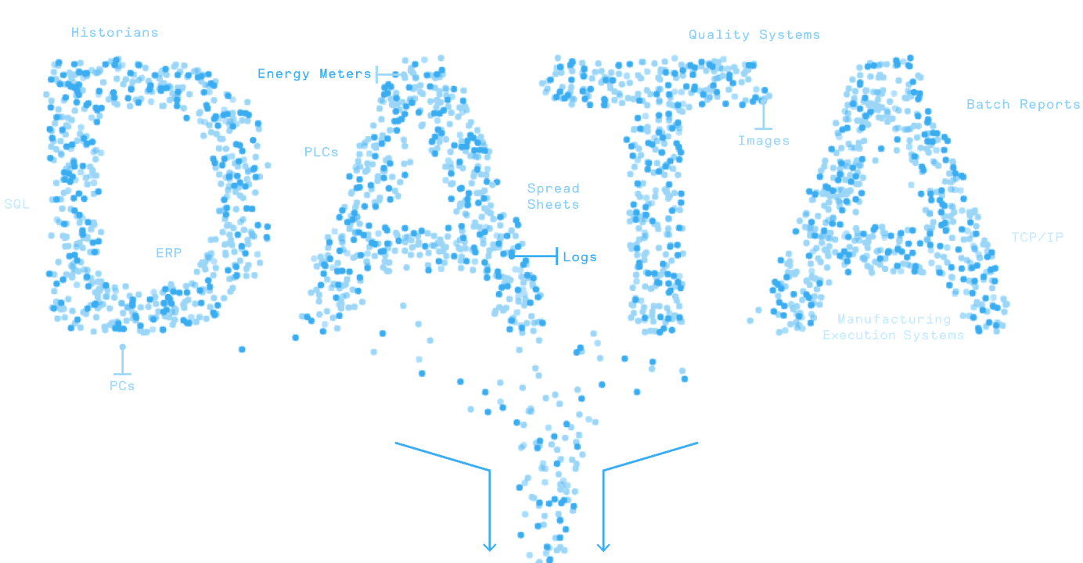
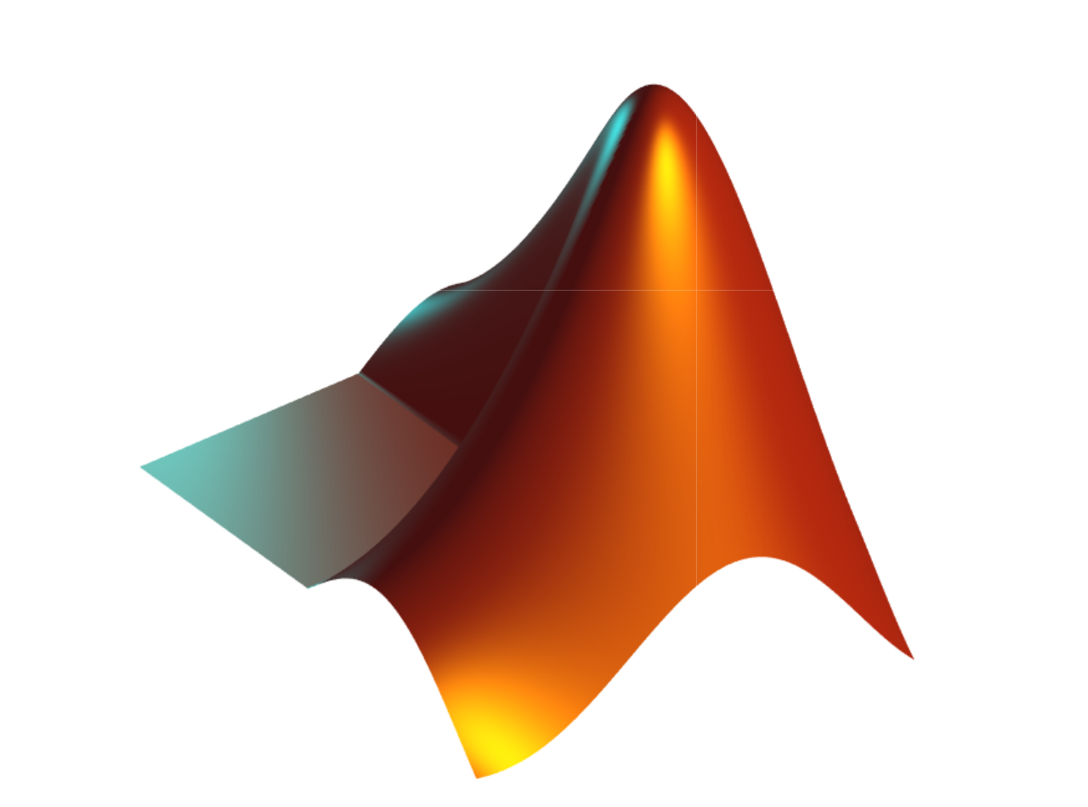

MATLAB Fundamental Laboratory Handbook (MATLAB)
Chapter 11 Problem Solving and Applications
Dr Leo Chen
leo.chen@ieee.org
1

Slide 2
11. 1 Lab
Objective: Practice Numerical Methods and Computational Techniques
Content：
Calculate the following definite integral:
Solve differential equations:
% Calculate definite integral
syms x t
f1=1/(1+x^2);
int(f1,-inf,inf)
% Solving differential equations
syms y(x) z(x)
m = dsolve(diff(y)==3*y-2*z , diff(z)==2*y-z)
m.y m.z

Slide 3
11. 2 Lab
Objective: practice data fitting
Content：
Load TemperatureData.mat.
Transform time to start at 0 in units of days.
Define a suitable nonlinear model.
Make an initial guess for the parameters.
Perform a nonlinear regression.
Evaluate & validate the fitted model.
edit tempReg_template.mlx
edit tempReg.mlx

Slide 4
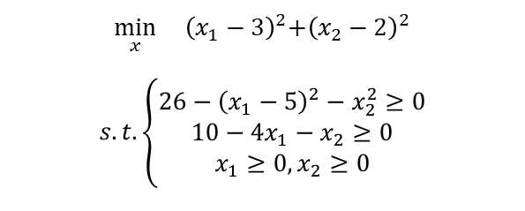
11. 3 Lab
Objective: Minimizing a mathematical function
Content：
1. For this minimum optimization Task:
What is the objective function? What are the design variables? What are the constraints?
2. Set up the problem in an Optimization Task.
3. Visualize the objective function and constraints.
$$\min_{x}{{ \left(x_{1}−3\right)}^{2}+{\left(x_{2}−2\right)}^{2}}$$
$$s.t.\left\{\begin{aligned}26−{\left(x_{1}−5\right)}^{2}−x_{2}^{2}≥0 \\ 10−4x_{1}−x_{2}≥0 \\ x_{1}≥0,x_{2}≥0\end{aligned}\right.$$
edit simpleOptimTask.mlx

Slide 5
11. 4 Lab
Objective: Clustering Corporate Bonds
Content：
Load the data in corpBondData.mat.
Extract the variables Coupon, YTM, CurrentYield,and RatingNum into a matrix.
Use k-means to cluster the data into three groups using the cosine distance metric.
Create a silhouette plot to evaluate the clustering.
Create a grouped scatter plot with Coupon on the x-axis and YTM on the y-axis, grouped by the results of the k-means clustering.
Bonus: Determine the optimal number of clusters by using the evalclusters function. Repeat steps 3-5.
edit clusterBonds_template.mlx
edit clusterBonds.mlx

